Slide 1
Web Page/Application Testing
A Hypothetical Case With CNN.com

Slide 2
Who is the client?
CNN is a U.S. based news outlet providing international news coverage 24 hours a day, 7 days a week. CNN.com is their online news portal offering multimedia news content.

Slide 3
What assumptions did we make?
We would assume that CNN would want to provide a premium user experience across multiple platforms and in a wide variety of use cases.

Slide 4
Defining a premium user experience.
A premium user experience provides an easy to use intuitive user interface to deliver multimedia content as quickly and as smoothly as possible utilizing the best features available in the particular use case instance.
Device
Browser
Internet Connection

Slide 5
Testing Types
User Testing
Synthetic / Automated Testing

Slide 6
Testing Tools
Human >Testing Lab with various devices/platforms
Automated >Testing Software such as Selenium

Slide 7
Human Testing Method
Real user testing requires a lab with a set of test devices that can be configured based on your test suite. The lab will also allow you to simulate different conditions such as connection speed and user load. You would want to create a matrix of test conditions and results and provide that matrix to the development team once completed.

Slide 8
Automated Testing Method
Using a tool like Selenium you can automate interaction with the web. You would want to automate test of all the user interactions.

Slide 9
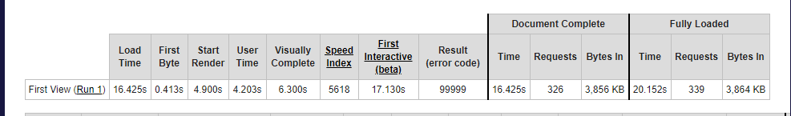
Webpagetest sample output

Slide 10
Deliverables
What do we want to be able to deliver to the client? We want to deliver the results of various tests and make recommendations on improving the site in ways that bring performance closer to providing a premium experience.

Slide 11
Alternate Hypothetical
What if the client where a bank? Similar success metrics with more of a focus on information security concerns.

Slide 12
Reference Materials
Git Hub Repository
>post link here<

